Slide 1
Introducing data analysis team
Geoff – experienced story-teller – bringing narrative to ideas
Ollie – flair for visualisations – the original thinker
Jonah – coding genius – the logical glue behind the team
Vicky – reflexivity – challenges perspectives on data analysis
Notes:
Shout out to Ollie - for the word cloud!

Slide 2
Reflective approach to the data
Awareness of “cultural lens”
Language
Production country
Need to think beyond own cultural lens to reflect the global nature of TV streaming
Questions –
who am I as a data analyst
How does this shape how I approach the story
Notes:
Who am

Slide 3
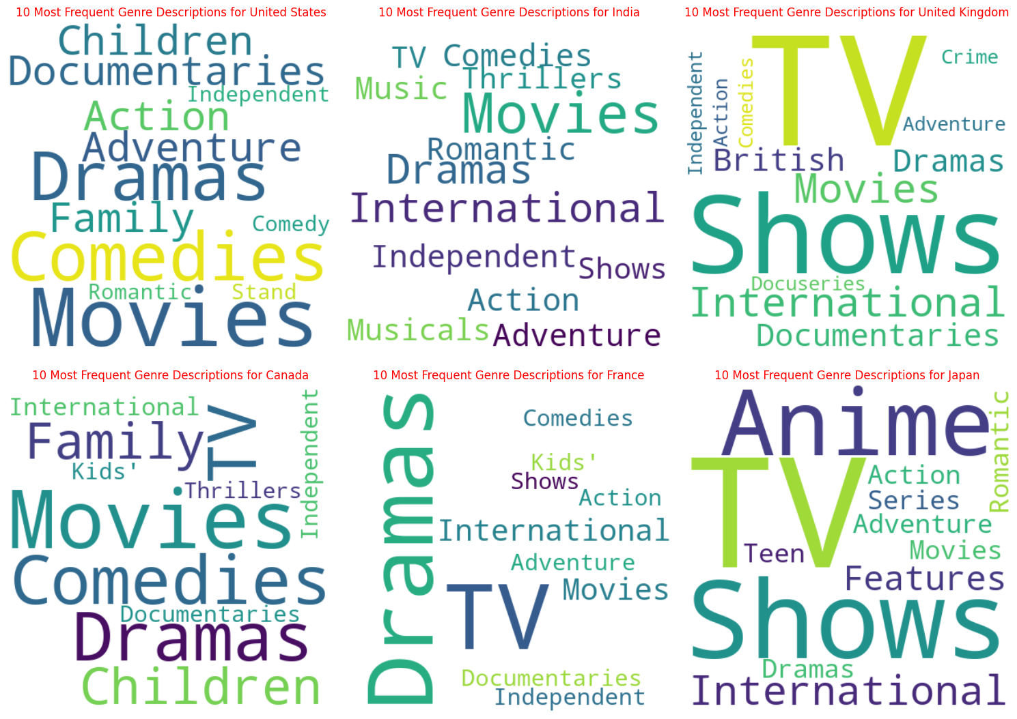
Countries are not homogenous
Notes:
France – emphasis on Dramas, Japan – Anime, Canada family focused, UK – TV shows (especially reality TV) – India Romantic – US and Canada comedy – all very culturally different – We cannot think of TV streaming as one thing but realise how cultural factors, country language etc shape opportunities for TV streaming.

Slide 4
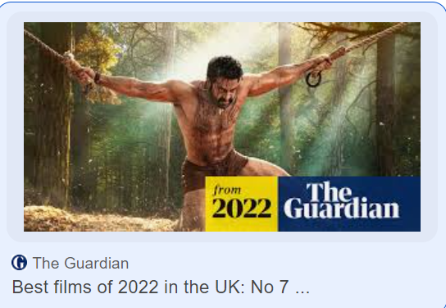





There is an opportunity for us all..
Notes:
International film and TV – to enrich lives – make travellers and ex-pats feel at home -

Slide 5
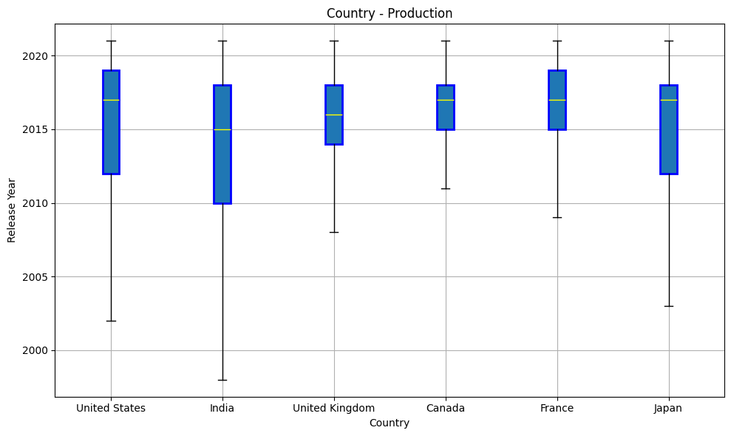
Distribution of Release Years (of Six major countries)

Slide 6
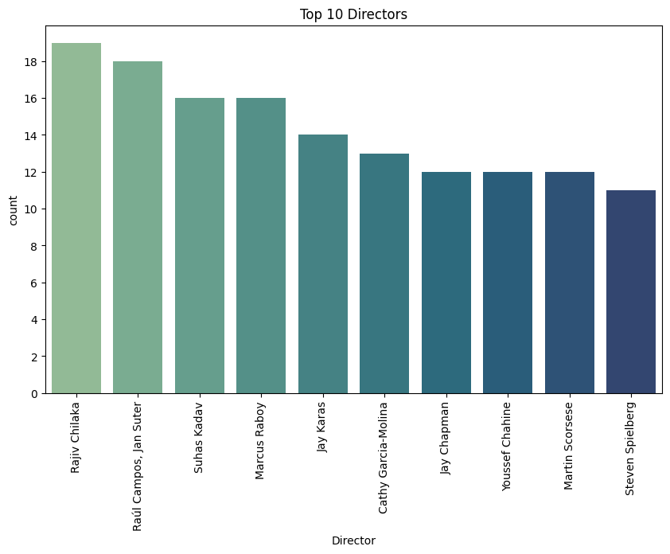
Top 10 Directors (most frequent)

Slide 7
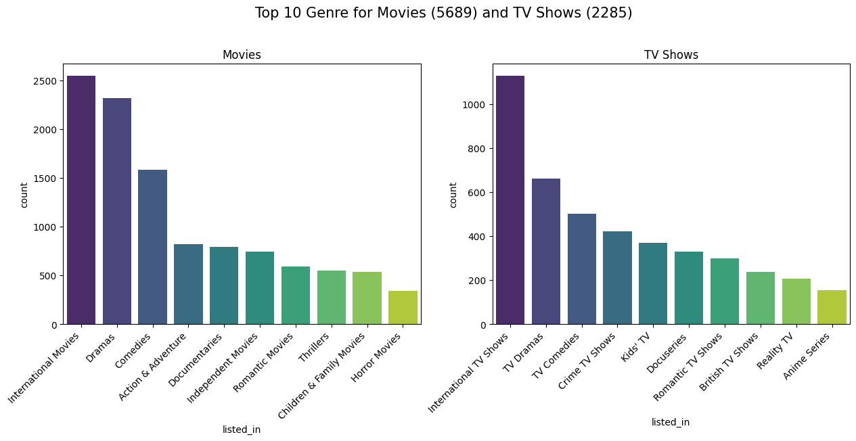
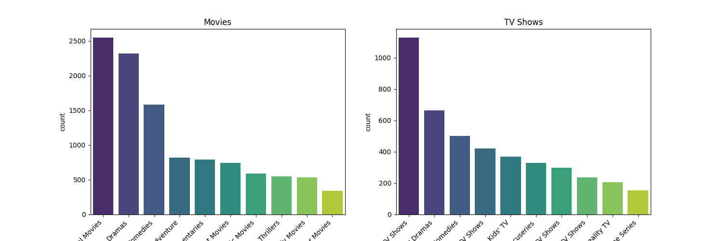
Top Categories (disaggregated)

Slide 8
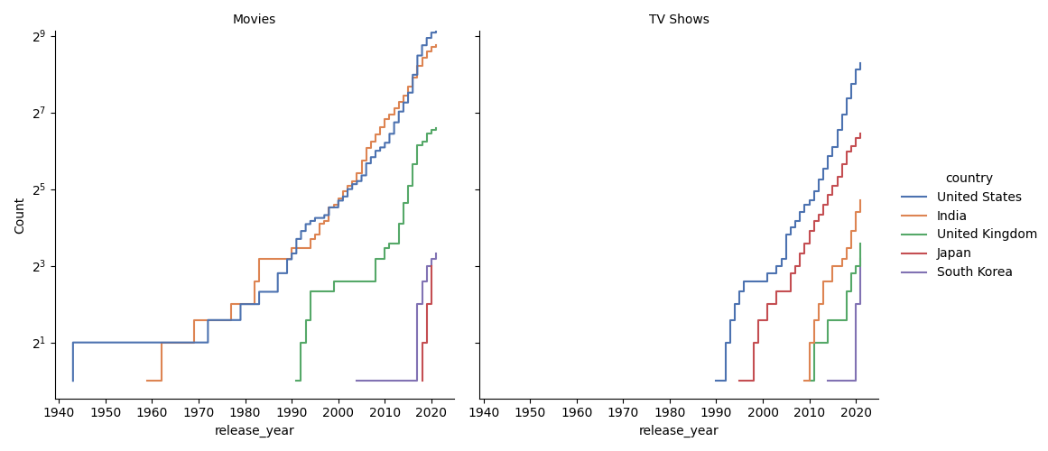
Industry Growth (Top 5 Countries

Slide 9
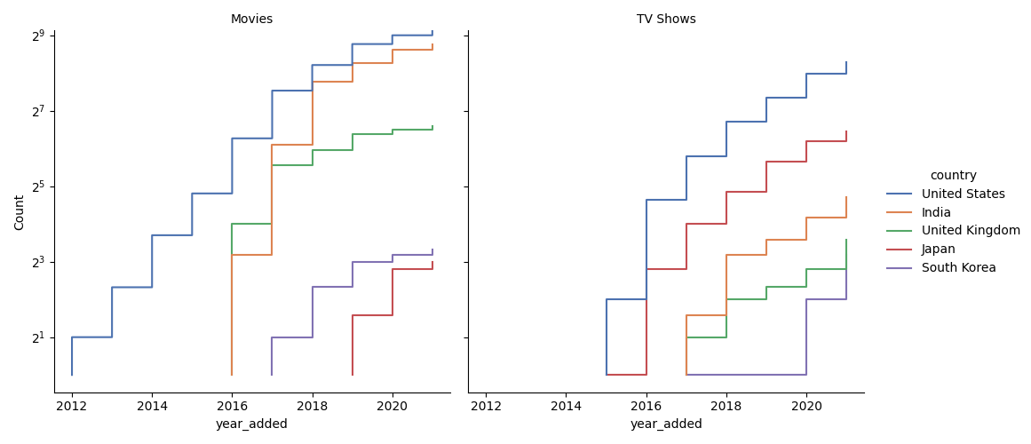
Title Growth (Top 5 Countries)

Slide 10
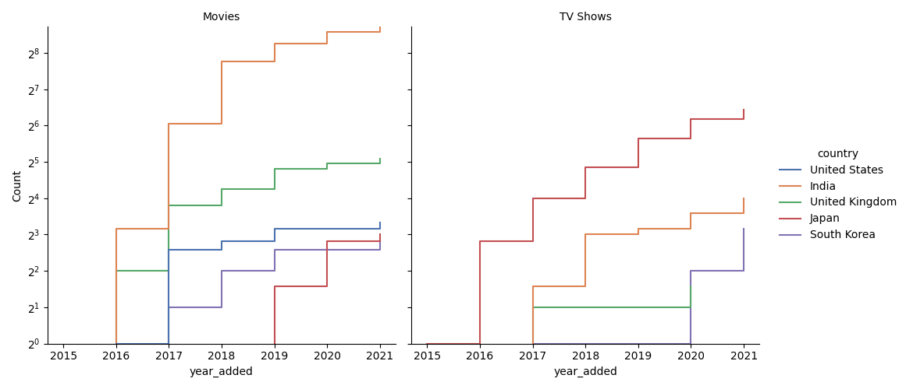
“International” Movies & TV Growth (Top 5 Countries)

Slide 11
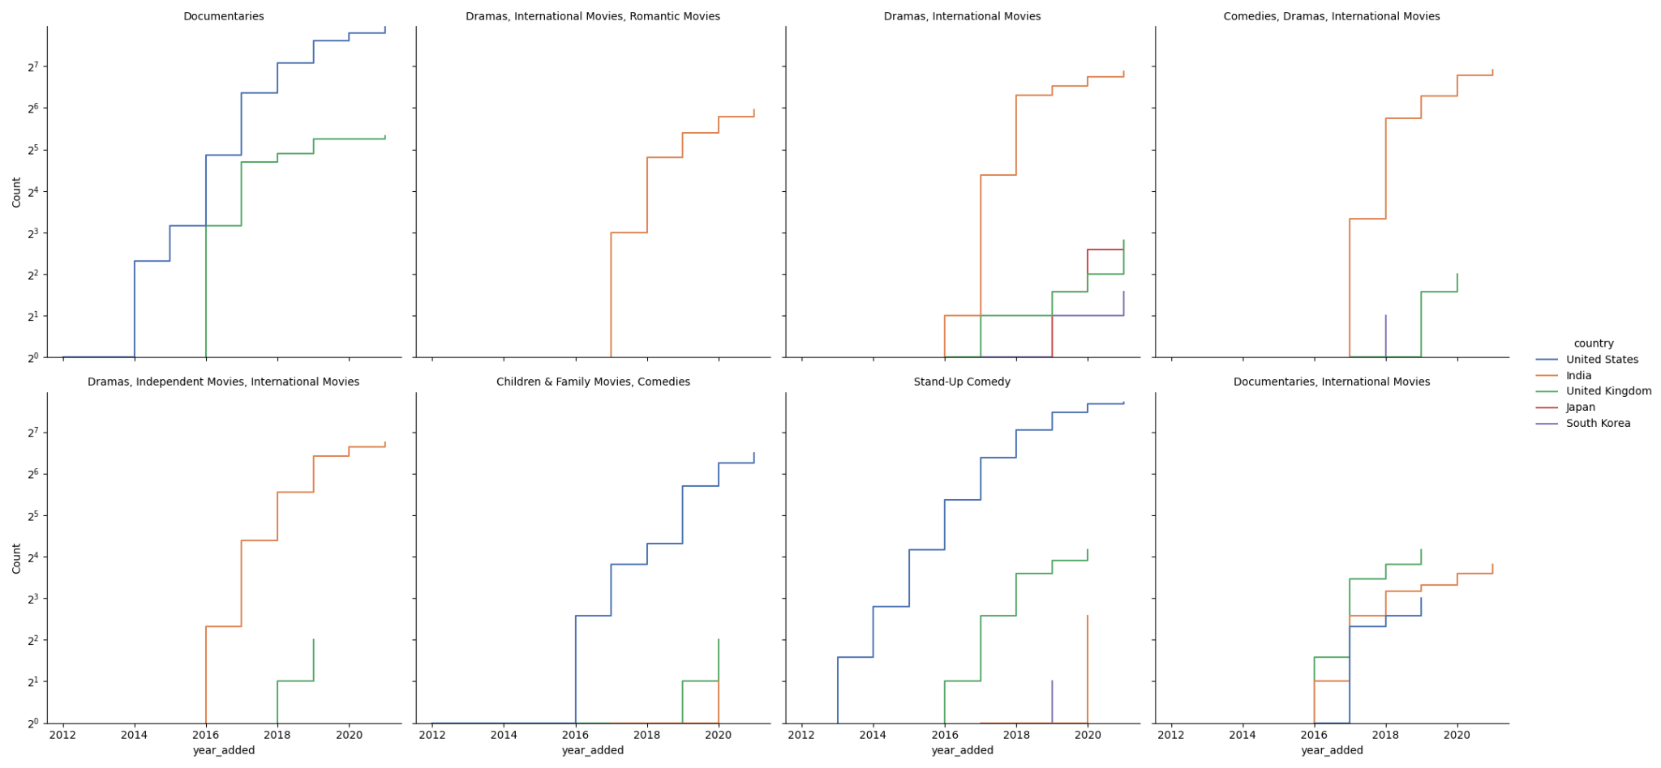
Movie Growth by in top Categories

Slide 12
Movie Growth by in top Categories

Slide 13
Recommendations
Recognise the potential growth in content produced outside the UK
Lesser known directors are producing quality Netflix products
Netflix has excelled at producing their own shows such as Stranger Things and are becoming less reliant on buying in products
Focus groups - gain insight from consumers about what is missing from TV streaming
Look at the future of the growth of some categories with a view to producing shows
Notes:
Type here

